Slide 1


WATERLESS TOILETS

Slide 2
Presenter: Denis McCarthy mb: 0404 020 242 www.greentoilets.au waterless@greentoilets.au

Slide 3
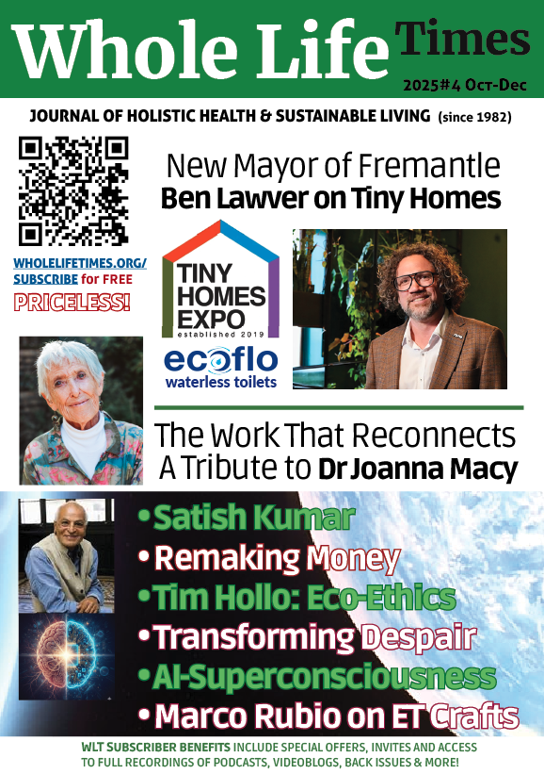
Tiny Homes Expo articles featured in Whole Life Times … get a free copy at Ecoflo Stall … or scan QR code

Slide 4
Topics
Why choose a composting toilet?
Main principles of composting
Four composting phases
Types of waterless toilets
Installing
Starting

Slide 5
Topics
Operating
Rotating
Mixing
Using composted waste
Models for Tiny Homes. Other Uses.
Q&A

Slide 6

Why choose a composting toilet
Free of odours, chemicals, pumps
Low maintenance and electrical costs
Saves a typical household 35,000L of water per year
Hygienic method of recycling human waste

Slide 7



Four main principles of composting
Aerobic bacteria breaks down waste much faster than anaerobic bacteria (smelly). The correct environmental conditions are needed for them to thrive.
1. 60% MOISTURE
2. AIRFLOW
60% of moisture content by weight. Too dry and the microbes will perish, too wet and conditions turn anaerobic.
Our systems incorporate ventilation and a fan or wind driven turbo vent, to encourage airflow for the oxygen-breathing microbes.

Slide 8


Four main principles of composting
3. CARBON & NITROGEN
4. WARM TEMPERATURES
Microbes utilise carbon for energy and nitrogen to grow and reproduce.
A C:N ratio of 25:1 is good, hence carbon-rich bulking agent is recommended.
Microbes prefer warmer climates.
Composting slows and can eventually stop when the temperature drops below 18°C.

Slide 9


Four phases of composting
1. Mesophilic Phase
Mesophilic organisms, which thrive between 20-30°C, break down the easily decomposable materials. The temperature increases as they proliferate.
2. Thermophilic Phase
Thermophilic organisms grow and thrive between 45-70°C. These rapidly decompose complex organic materials, generating high temperatures that kill pathogens.

Slide 10


Four phases of composting
3. Cooling Phase
Mesophilic organisms return as it cools down. Actinobacteria and perhaps fungus and moulds decompose the larger, more complex material at a slower pace.
4. Curing Phase
Eventually any leftover pathogens are killed off. The pile matures into a humus, with the appearance and consistency similar to fresh potting mix.

Slide 11






TYPES of waterless toilet systems
Split Systems
Clearance under the floor available
Self-Contained Systems
No clearance under the floor available
Batch
Continuous
Container
Extraction

Slide 12
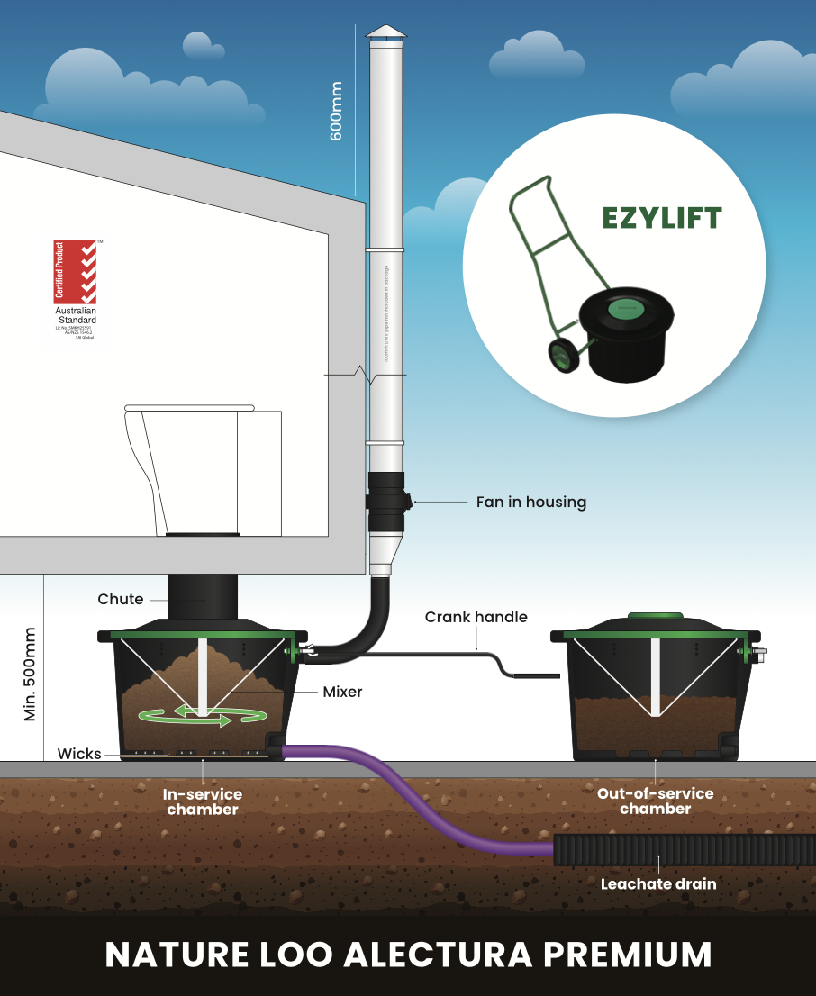
INSTALLING a split composting toilet
Clearance under the floor for the chamber
Vent above the roof
Leachate drain underground

Slide 13
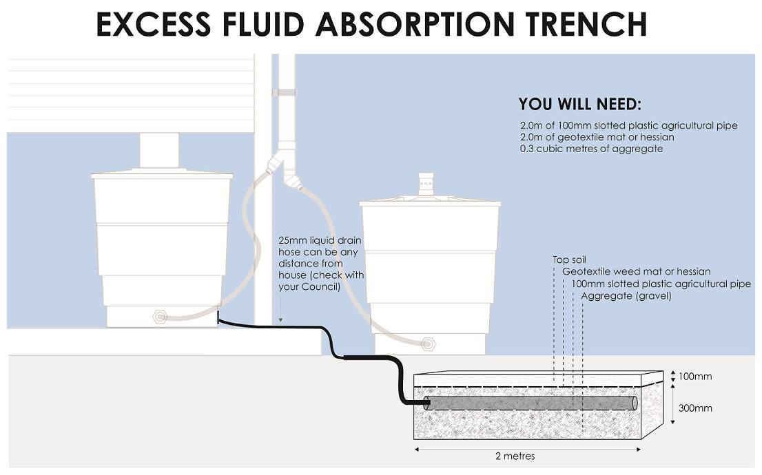
INSTALLING a “leachate drain”

Slide 14
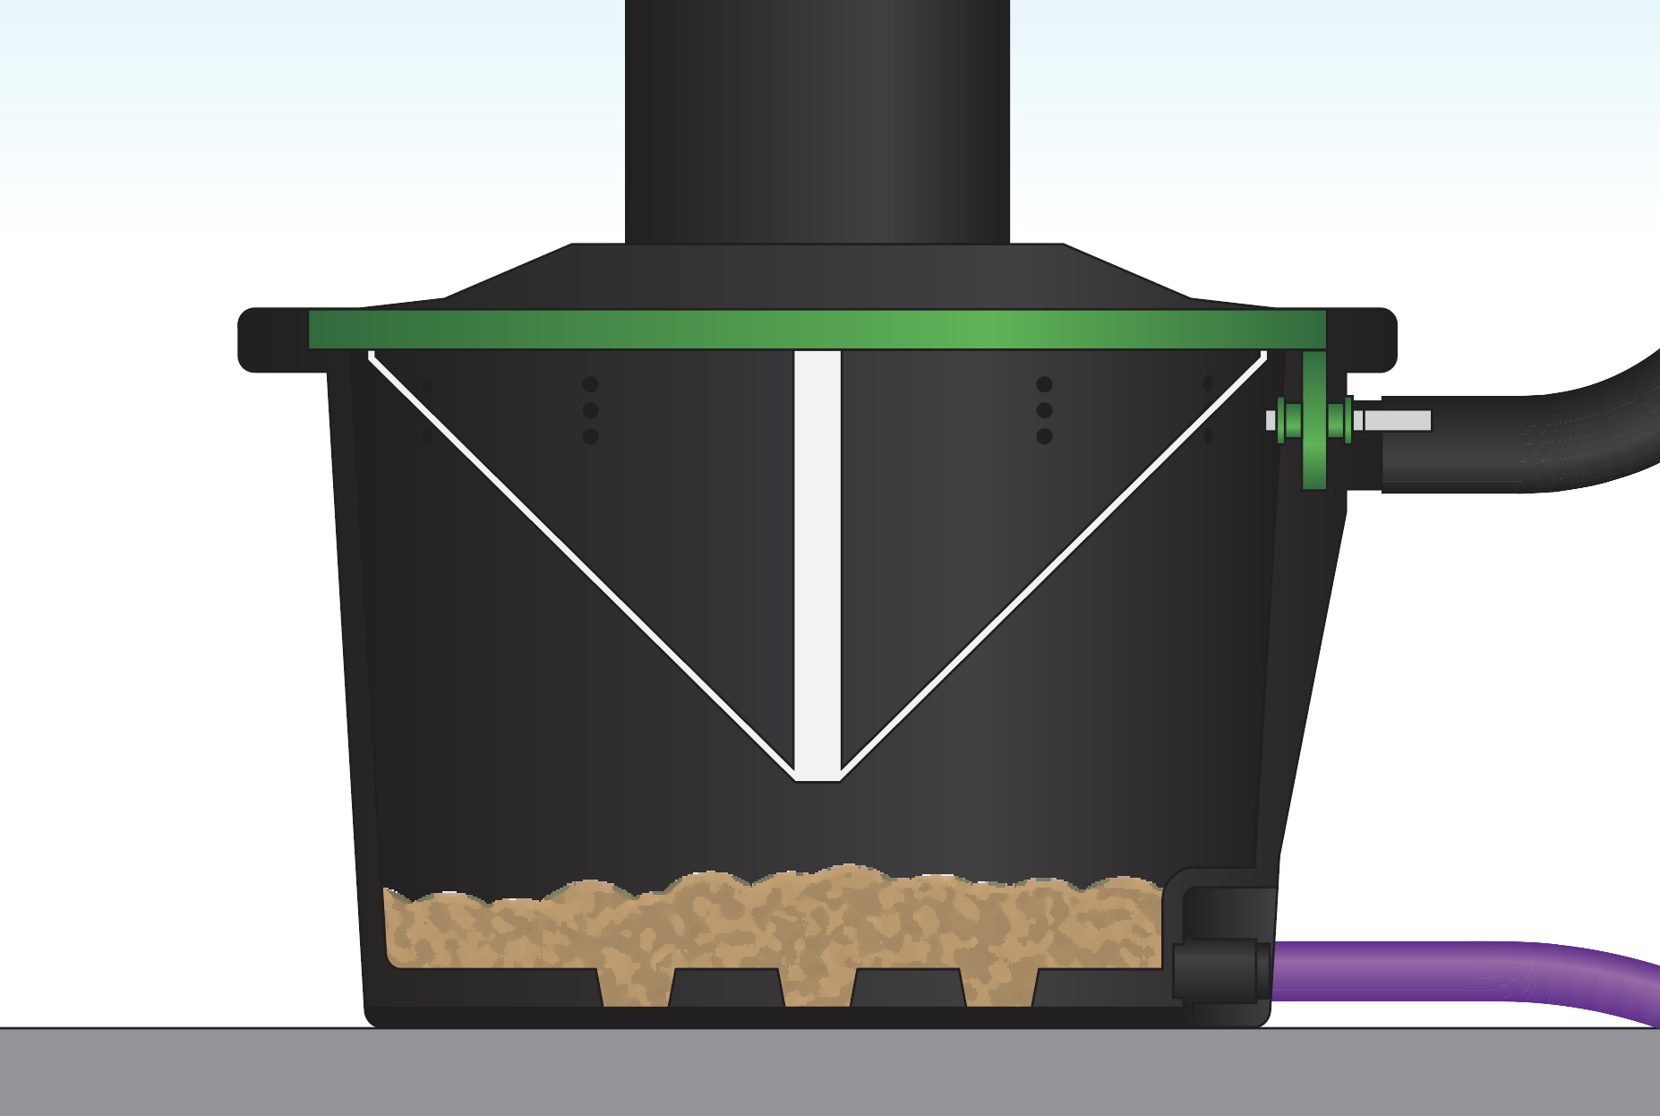
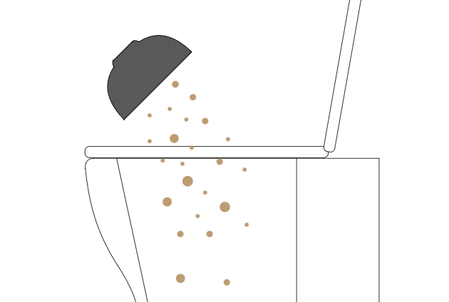
STARTING a composting toilet
Add a starter bed of bulking agent.
After a few days of pooing, add some microbes mixed with warm water.
Repeat step 2 in about 14 days.

Slide 15



OPERATING a composting toilet
After every LIQUID (PEE) deposit: Simply close the lid
After every SOLID (POO) deposit:
Add one generous cup of bulking agent
Spray enzyme solution around the pedestal
Close the lid

Slide 16
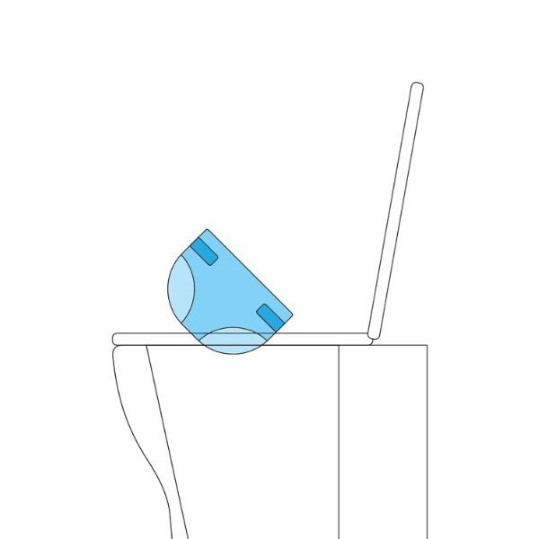
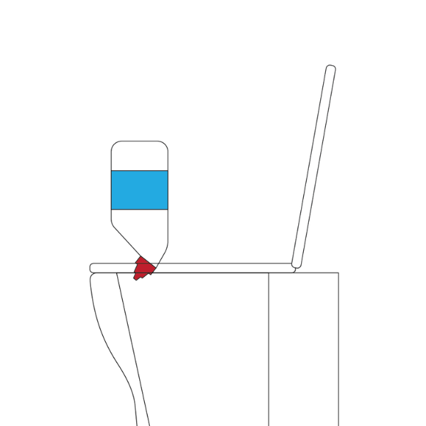
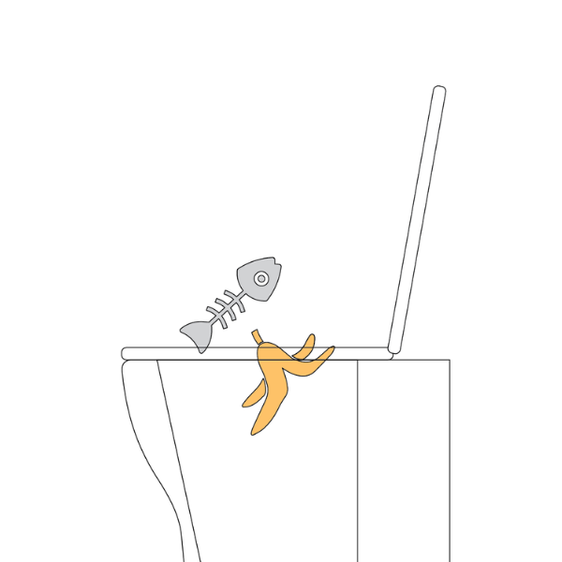
OPERATING a composting toilet
Do NOT dispose into the chamber:
Sanitary products and nappies
Chemical products or cleaning agents
Food waste

Slide 17
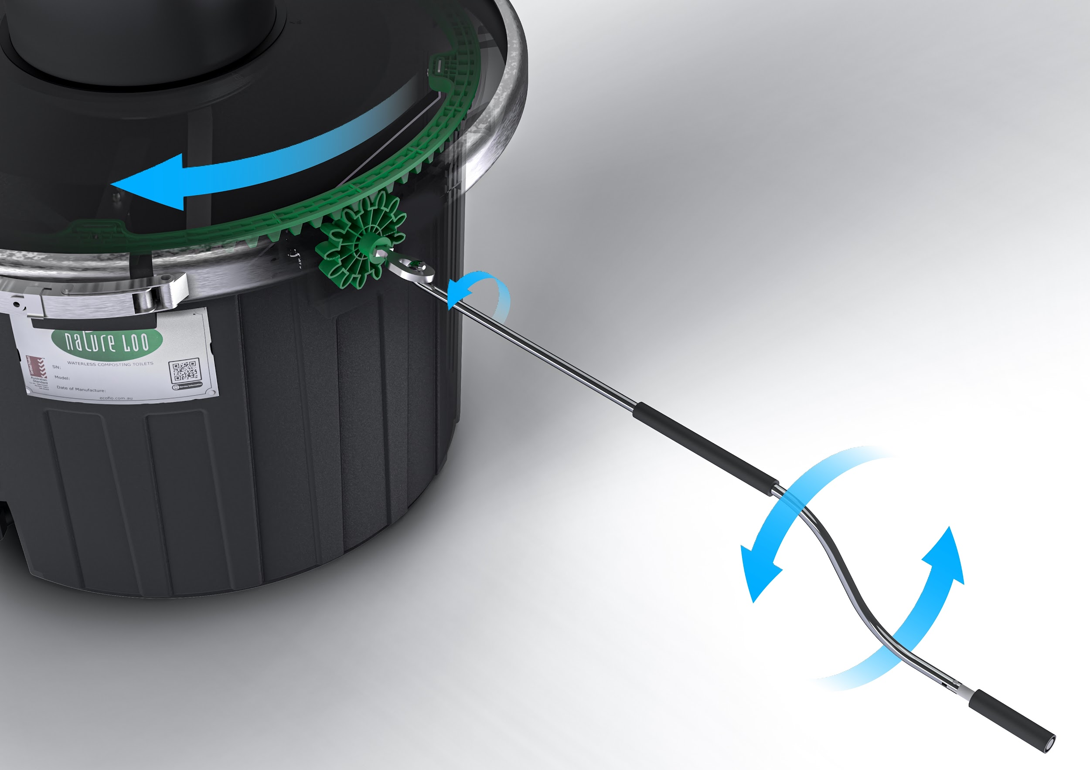
MIXING a composting toilet
Flattens and aerates the compost pile
Accelerates the composting process
We recommend mixing batch systems around once a fortnight
The larger the system, the less often you would need to mix it

Slide 18
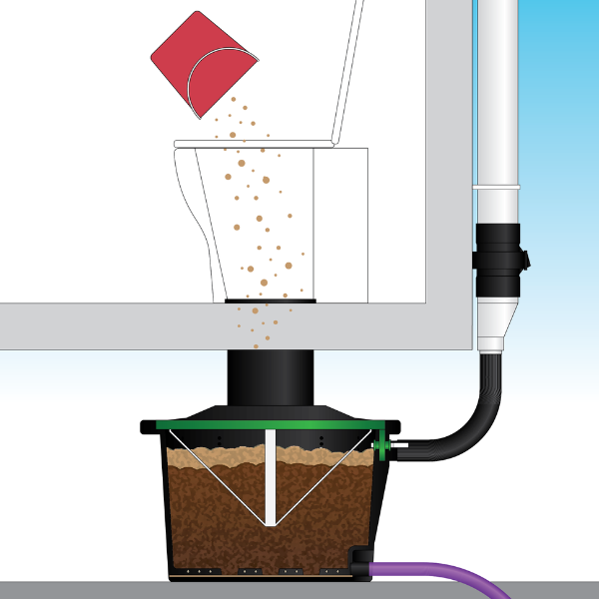
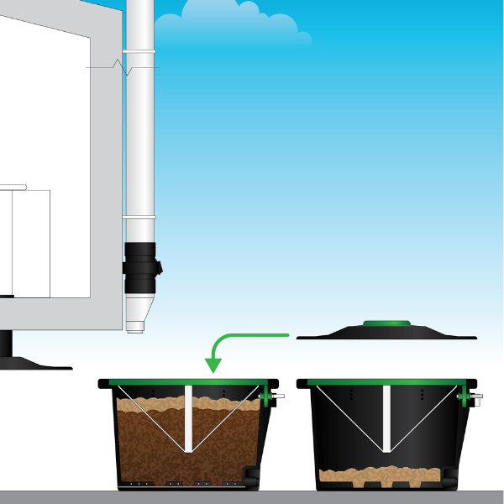
ROTATING a batch composting toilet
1. Cover the compost pile with a shallow layer of bulking agent.
2. Add a starter bed to the new chamber, and place its lid onto the full chamber.

Slide 19
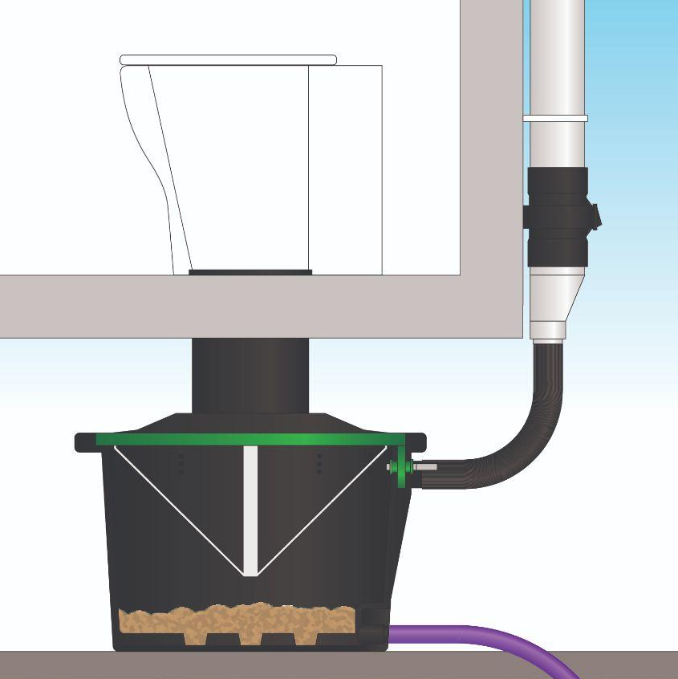

ROTATING a batch composting toilet
3. Connect the new chamber.
4. Leave the full chamber in a sunny position to finish composting.

Slide 20
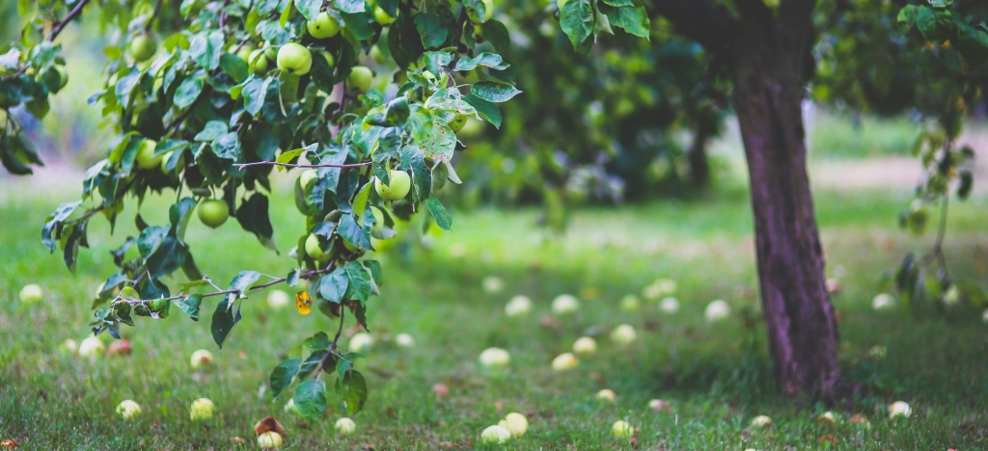
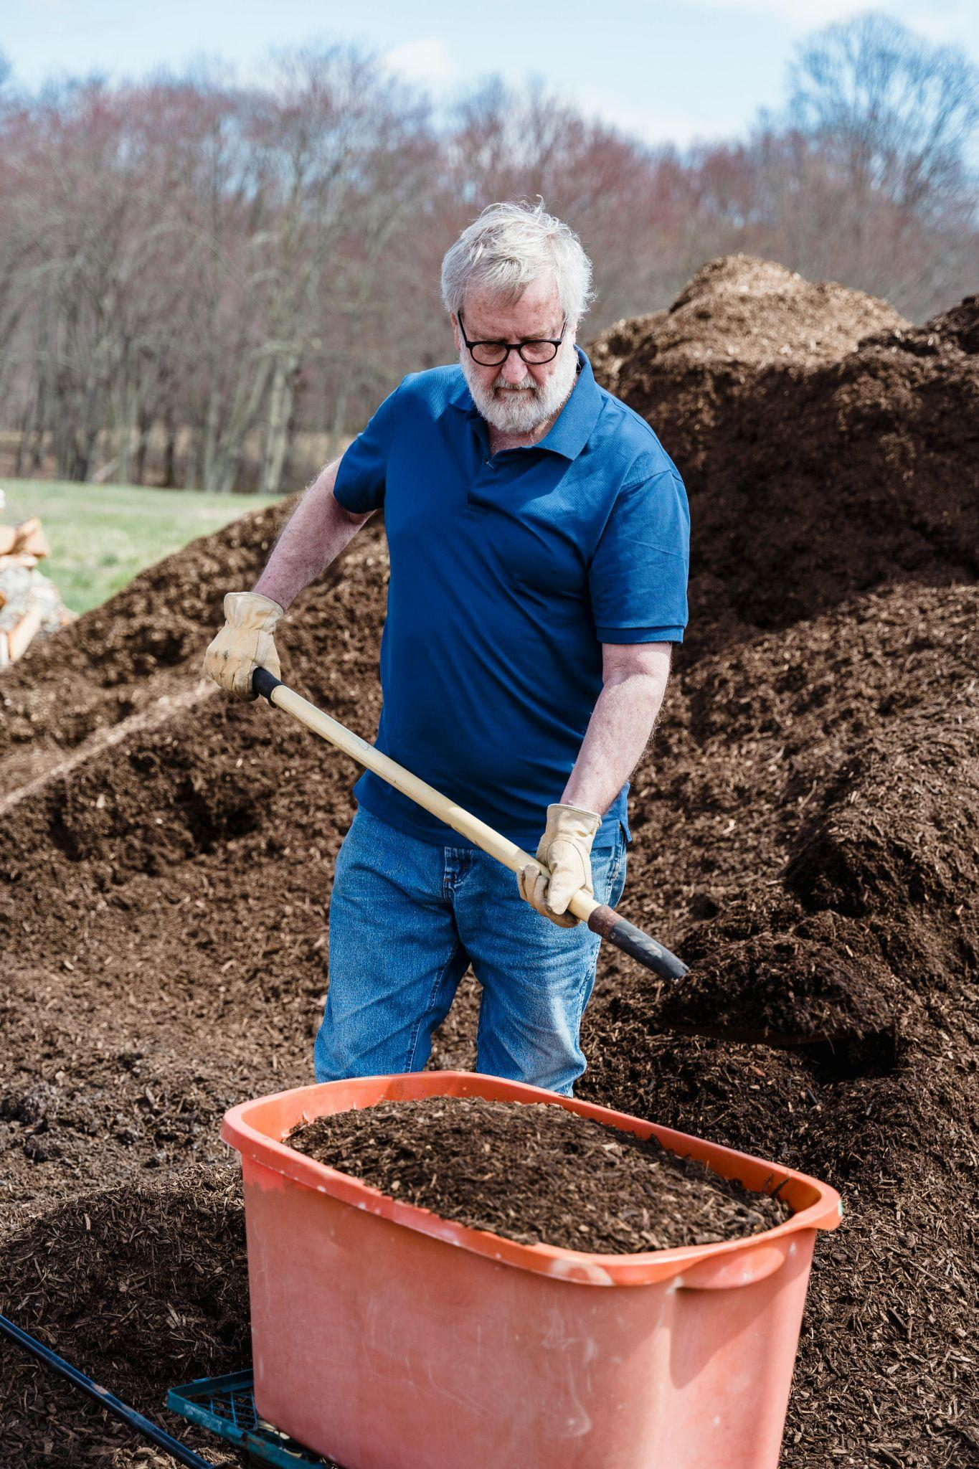
USING finished compost
How can you tell if your compost pile is ready?
Appears slightly crumbly and moist with an earthy smell, similar to fresh potting mix.
No longer producing heat and will have reduced in size by about half.
Organic material and toilet paper should no longer be visible.
Where to use composted waste?
Bury it 10cm below ground around fruit or nut trees, lawns, flower beds and shrubs.
Avoid contact with edibles such as vegetables and herbs.

Slide 21
NatureLoo™ ALECTURA : Comfort & Premium
Fully certified & approved in WA
Built specifically for tiny homes
Multi award winning innovative design
Full-time use up to 2-3 people.
Each optional extra chamber adds up to 2-3 people to its full-time capacity.

Slide 22
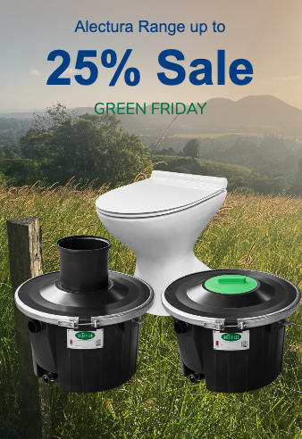
NatureLoo™ ALECTURA : Comfort & Premium
Part-time use up to 4 people
Each optional extra chamber adds up to 4 people to its part-time capacity.
Comfort (no Ezylift)
Premium includes Ezylift

Slide 23
NatureLoo™ ALECTURA : Comfort & Premium

Slide 24
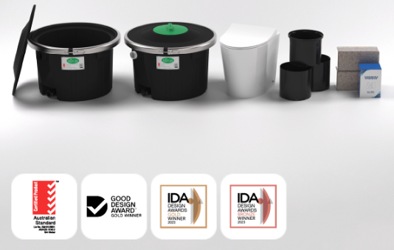
NatureLoo™ ALECTURA Comfort
December Sale Price
$1,595.00
Usual price $1,850.00
Save $255.00
Includes porcelain pedestal
Other inclusions see ecoflo.com.au/product/nature-loo-alectura-comfort/

Slide 25
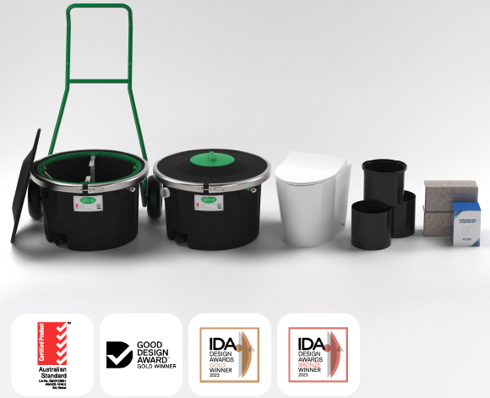
NatureLoo™ ALECTURA Premium composting toilet
December Sale Price
$1,995.00
Usual price $2,775.00
Save $780.00
Includes porcelain pedestal
Other inclusions see ecoflo.com.au/product/nature-loo-alectura-premium/
WA orders: sms 0404 020 242 em: waterless@greentoilets.au

Slide 26
Bionova Self-Contained Composting Toilet
All-in-one, fully automatic, self contained composting toilet
Standard “Cabin” model $2,550.00
“Cabin Plus” model $2,650.00
ecoflo.com.au/product/bionova-self-contained-composting-toilet/
WA orders: sms 0404 020 242 em: waterless@greentoilets.au

Slide 27
Bionova Self-Contained Composting Toilet
Uses: Caravans, Vans & RVs, Trucking, Mining, Tiny Homes, Boats, On-Slab, Shipping Containers
“Cabin” for 3 People (for full time use)
“Cabin Plus” for 3-5 People (FT use)
ecoflo.com.au/product/bionova-self-contained-composting-toilet/

Slide 28
Other Uses … of Alectura, Bionova & other models
RVs and Vans
Caravans
Tour Buses
Walking Trails
National Parks
Wineries
Mines Sites
Sport Clubs
Cemeteries
Residential
Remote communities

Slide 29
Questions?

Slide 30

WA: Denis McCarthy mb: 0404 020 242 www.greentoilets.au waterless@greentoilets.au

Slide 31
Thanks for listening!

